Slide 1
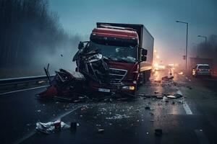
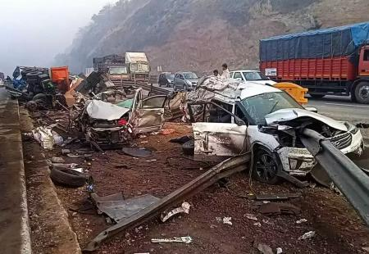


Presentation On Road Accidents in India.
Presented By :
Gangadhar Tiwari
Date : 27-03-2025
@Gangadahr Tiwari
GitHub/Gangadhar Tiwari

Slide 2
AGENDA
Introduction
Objective
Data Gathering
Insight
Conclusion

Slide 3
Introduction :
This report presents an analysis of road accidents in India using the dataset containing 30,000 records. The analysis includes accident distribution by location, severity, vehicle type, weather conditions, and other factors.
So, in this we are majorly focus on below points:
Accident Counts by State
Accident Counts by City
Accident by Vehicle Type
Accident Counts by Severity
Accident Counts by Day of the Week
Accident Over the Years
Accident Counts by Weather Conditions

Slide 4
Objective :
Identify High-Risk Areas:
Analyze Contributing Factors:
Improve Road Safety Measures:
Reduce Accident Severity & Fatalities:
Support Indian Government’s Road Safety Initiatives:
By analyzing accident data, this study aims to assist policymakers, traffic authorities, urban planners, and the Indian government in making informed decisions to enhance road safety and reduce the overall number of accidents.

Slide 5
Data Gathering
The data has been acquired from Kaggle in CSV format.
After that, I cleaned the data in Power Query Editor inside Power BI, ensuring the correct format, removing null values, and verifying data types.
Then, I loaded the cleaned data into Power BI and started creating visualizations to analyze road accidents.
Data Link: Data by kaggle

Slide 6
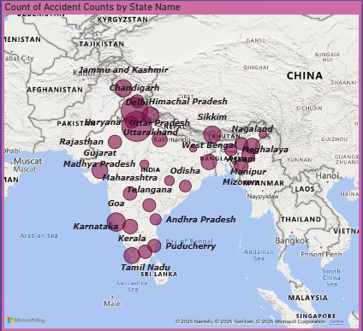
Insights: Accident Counts by State (In Map)
Total Accidents Recorded: 30,000 accidents.
Delhi recorded the most accidents, with 2,015 incidents.
Tripura reported the least accidents, with 742 incidents.

Slide 7
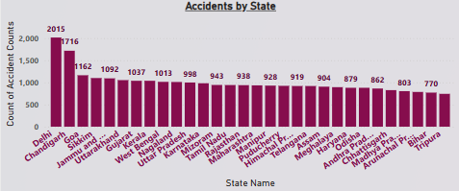
Insights: Accident Counts by State
Highest Accidents: Delhi recorded the most accidents, with 2,015 incidents.
Lowest Accidents: Tripura reported the least accidents, with 770 incidents.

Slide 8
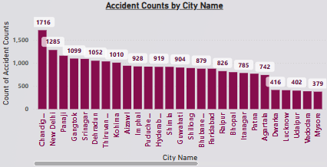
Insights: Accident Counts by City
Highest Accidents: Chandigarh recorded the most accidents (1,716 cases).
Lowest Accidents: Mysore had the least at 379 cases.

Slide 9
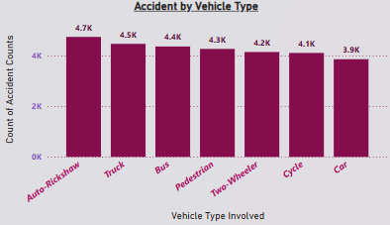
Insights: Accidents by Vehicle Type
Auto-Rickshaw was involved in the most accidents, with 4,749 incidents.
Car recorded the least accidents among the major vehicle types, with 3,866 incidents.

Slide 10
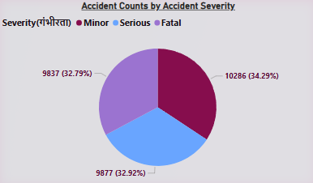
Insights: Accident Counts by Accident Severity
Minor accidents are the highest, with 10,286 cases (34.29%).
Serious (9,877, 32.92%) and Fatal (9,837, 32.79%) cases are nearly equal.
All three severity types have a similar share, requiring safety measures.

Slide 11
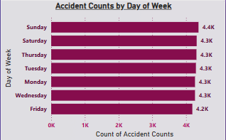
Insights: Accident Counts by Days
Sunday recorded the highest number of accidents (4,369 cases).
Friday had the lowest number of accidents (4,186 cases).
Steady Distribution: Accident counts remain fairly consistent across all days.

Slide 12
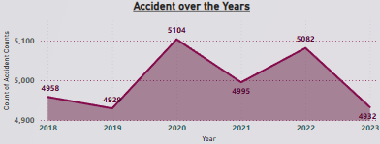
Insights: Accidents Over The Year
Peak in 2020: The highest accidents occurred in 2020 (5,104 cases).
Lowest in 2023: 2023 recorded the lowest at 4,932 cases.
Fluctuating Trend: Accidents varied yearly, with notable drops in 2019 and 2023.

Slide 13
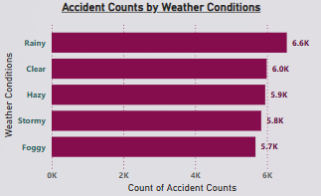
Insights: Accident Counts by Weather Condition
Rainy Conditions: The highest number of accidents occurred in rainy weather (6.6K cases).
Foggy Conditions: The lowest accidents were recorded in foggy weather (5.7K cases).
Clear Weather Risks: Even in clear weather, 6K accidents were reported, indicating other influencing factors.

Slide 14
Conclusion :
Improved Traffic Management: - Implement stricter traffic monitoring, especially in high-accident zones. - Increase the number of traffic police checkpoints.
Road Safety Awareness Programs: - Conduct campaigns to educate drivers about safe driving habits. - Special focus on two-wheeler and auto-rickshaw drivers.
Enhanced Road Infrastructure:
- Repair damaged roads and ensure proper maintenance of highways. - Improve road lighting in accident-prone areas.
Weather-Based Safety Measures:
- Introduce precautionary measures for driving in bad weather conditions. - Encourage the use of fog lights and speed restrictions during foggy conditions.

Slide 15
Conclusion : Part – 2nd
Stronger Regulations on Alcohol Consumption:
- Enforce strict penalties for drunk driving. - Increase alcohol checkpoints at night.
Better Public Transport Planning:
- Encourage the use of public transport to reduce traffic congestion. - Implement policies to regulate the number of vehicles on the road.
Accident Hotspot Identification and Monitoring:
- Use AI and data analytics to identify high-risk areas. - Install CCTV cameras and enforce stricter monitoring in these regions

